Slide 1
Higher Biology
Threats to Biodiversity
Mr G R Davidson

Slide 2
Threats to Biodiversity
Natural resources can be overexploited by humans and this reduces the biodiversity, e.g. over fishing in the North Sea.
In order to prevent overexploitation, fishing quotas have been introduced to try to allow fish stocks to increase in number and so recover.

Slide 3
Threats to Biodiversity
In some cases, by humans or natural disaster, a population can be drastically reduced.
If the number of survivors is very small, genetic diversity is lost and this could lead to the population struggling to adapt to future changes in the environment.
This is called the bottleneck effect.

Slide 4
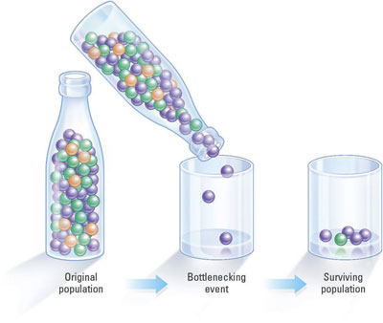
Bottleneck Effect

Slide 5
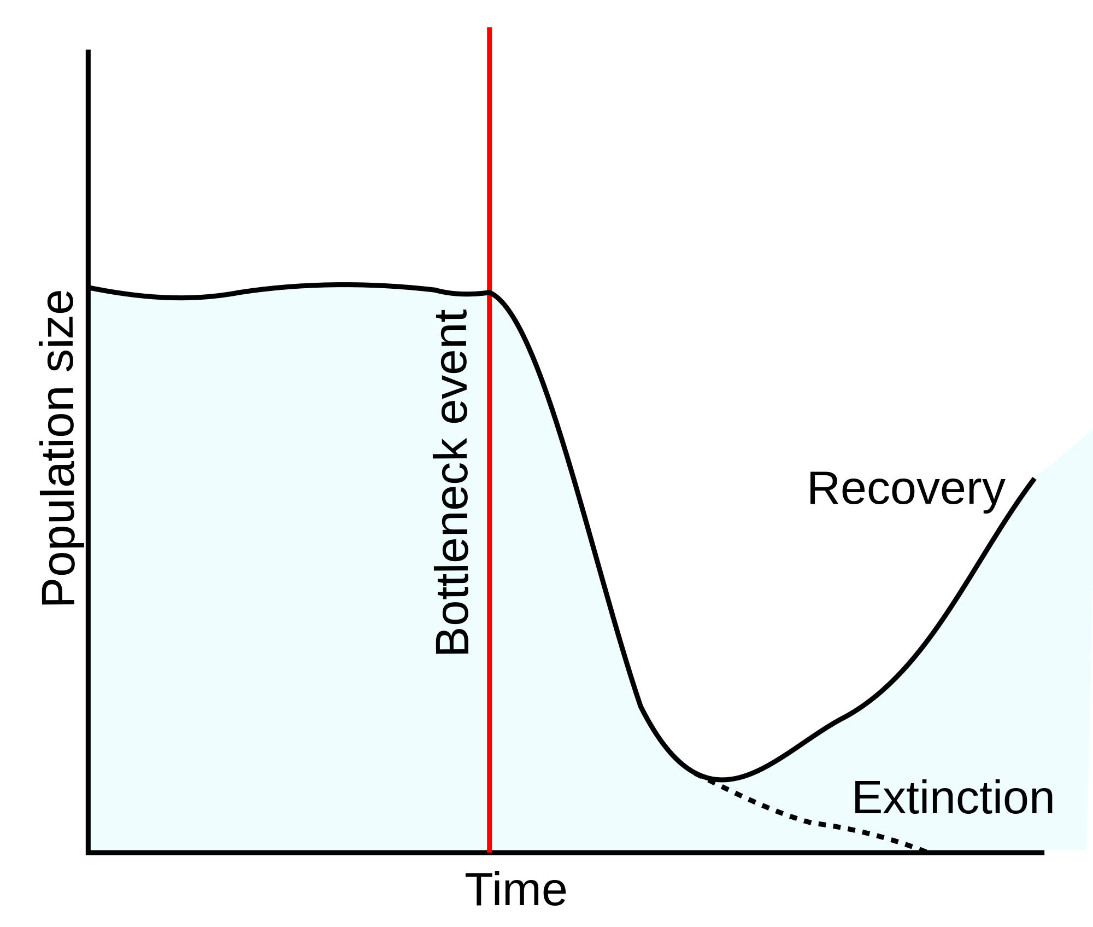
Bottleneck Effect

Slide 6
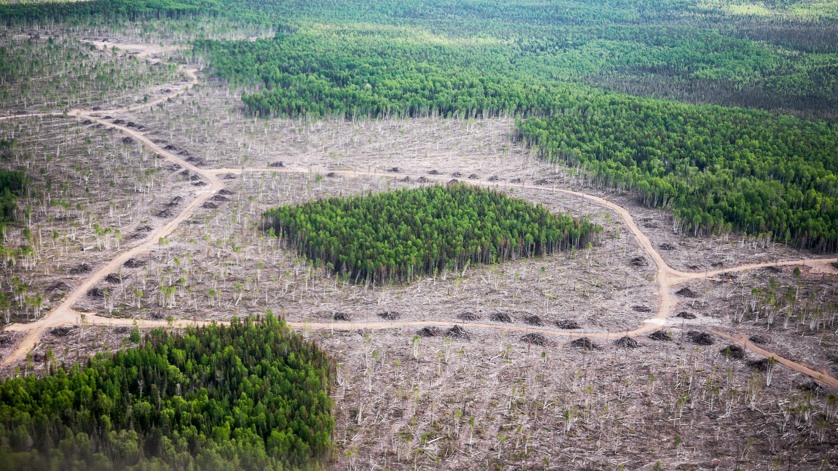
Habitat Fragmentation

Slide 7
Threats to Biodiversity
Habitat fragmentation is the process where humans divide a habitat into smaller segments, e.g. clearing areas of forest, building dams, etc..
The edges of the smaller segments then degrade, making the segments even smaller.
These smaller fragments can only support smaller populations and so the biodiversity is lowered.

Slide 8
Threats to Biodiversity
One way to solve the fragmentation problem is the creation of habitat corridors.
These are strips of habitat used to link larger fragments, e.g. a wooded bridge over a motorway which allows animals to move safely between two areas.

Slide 9
Introduced, Naturalised & Invasive Species
Populations native to a particular ecosystem are said to be indigenous.
An introduced species is a non native species either put there intentionally or accidentally by humans.

Slide 10
Introduced, Naturalised & Invasive Species
When these non-native species become established and can successfully reproduce, we call them naturalised species.
If they start to eliminate native species then they become an invasive species.

Slide 11
Introduced, Naturalised & Invasive Species
Invasive species tend to have a negative impact on their new environment as their natural predators and pathogens are not present, and this allows a population explosion.
This results in a loss in biodiversity.

Slide 12
Climate Change
Climate change is a natural process on Earth.
However, carbon dioxide and methane are “greenhouse gases” produced by humans and they trap heat from the Earth’s surface.

Slide 13
Climate Change
This greenhouse effect is resulting in an increase in the Earth’s temperature.
We know this as global warming.
Methane and carbon dioxide levels are increasing because of burning fossil fuels, certain types of agriculture and deforestation.

Slide 14
Climate Change
Because this climate change is being brought about by human activity, we call it anthropogenic climate change.
The result of this is a decrease in biodiversity.
Climate change does not suit specialist species which have a highly specialised way of life and habitat.

Slide 15
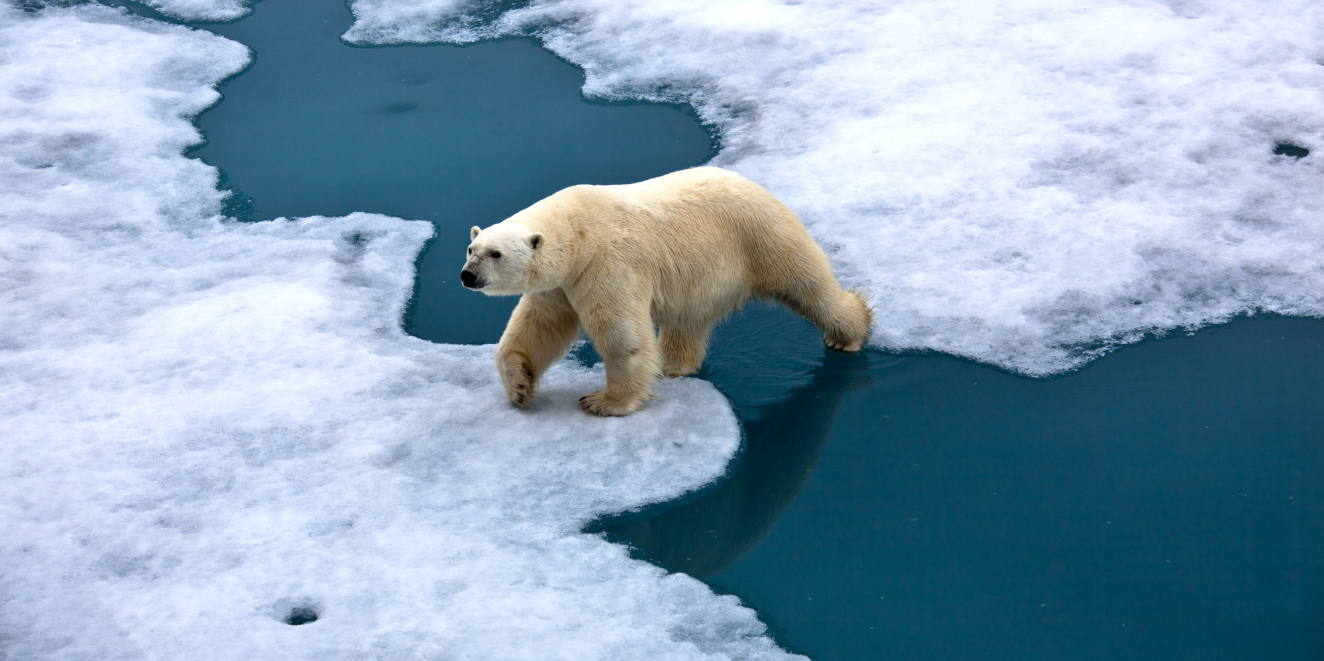
Specialist Species

Slide 16
Climate Change
Generalist species cope better with climate change because they can
Adapt rapidly
Extend their range to match climate change
Tolerate a wide range of climates.

Slide 17
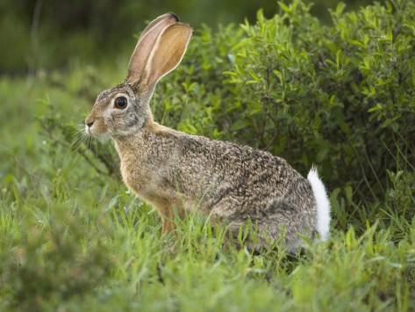
Generalist Species

